Slide 1
Game Feeling
Mack 2023

Slide 2
Learning Objectives
Games evoke emotions and feelings from their audience.
Constructing a game to evoke specific emotions is likely to lead to the most cohesive experience.
The same game experience can lead to different feelings for different audiences.
Fun can be sorted into 8 different categories.
Specific kinds of fun produce different feelings in games.
Different kinds of fun appeal to different players.

Slide 3
So You want to be a Game Designer
So you want to be a game designer? The eloquent and skilled people at Extra Credits have covered this topic, with excellent advice to aspiring game designers. It is a fun and entertaining video, and they have a lot of very good points to share. Watch the video below or go here.

Slide 4
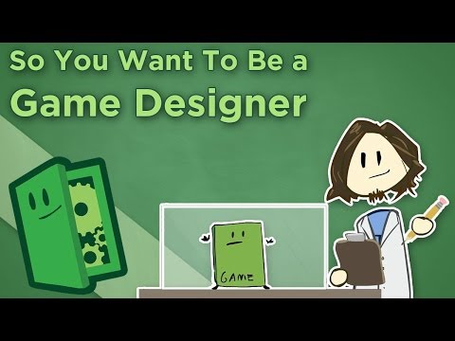
So You want to be a Game Designer

Slide 5
Getting it all out
Divide up into groups of 3-4.
write down 3 feelings on 3 separate cards (positive and negative) when they play games (two words maximum).
Place their cards face down on the table.

Slide 6
Discussion Within Group
Each student then takes turns to flip one of the feeling cards face up.
The owner of that card explains why they wrote that feeling on that card.

Slide 7
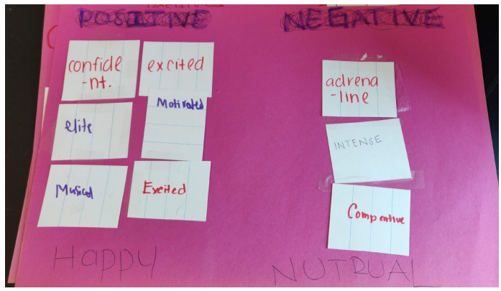
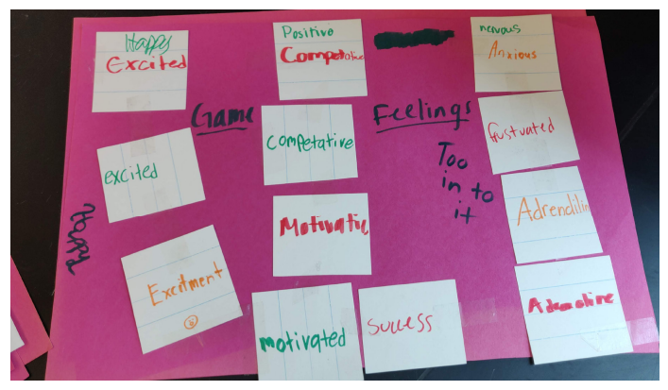
Sort them Feelings
Finally, as a group, create categories that best describe their cards and sort the feeling cards that they have accumulated into these categories.

Slide 8
What does this comes down to?
Games evoke emotions and feelings from their audience.
Constructing a game to evoke specific emotions is likely to lead to the greatest, most cohesive experience.
The same game experience can lead to different feelings for different audiences.

Slide 9
8 Kinds of Fun Introduction
As seen in the video from Lesson 1, Mark Rosewater explains that designers are focused primarily on the idea of curating an experience for players.
When we know what type of feeling we want the player to experience, we also want to know what kinds of fun can best create this experience and how our game can produce these kinds of fun.
We also talk about how types of fun can be combined to create a more cohesive experience for players.

Slide 10
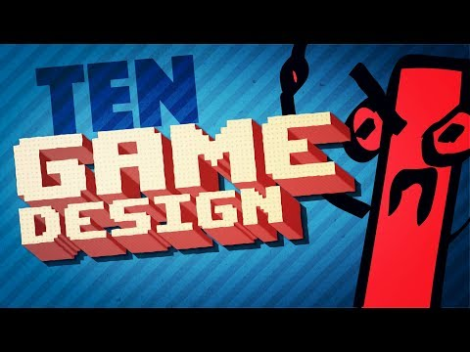
8 Kinds of Fun Introduction

Slide 11
Types of Fun
The types of fun are not exclusive. Some types of fun lend themselves well to being combined with others. For example, sensation, fantasy, and narrative can typically form a cohesive package as they tend to create immersive and resonant experiences. Some types of fun don’t blend well together.
E.g., challenge and narrative (as shown in the video).

Slide 12
Sensation
Some examples of fun derived from the senses:
Touch: Collecting objects, moving board game pieces around.
Auditory: Music or audio feedback that can create a response in the player.
Visual: Splendor that can create a sense of wonder or magnificence, visual effects, such as rewards that play on the screen or victory screens.

Slide 13
Fellowship
Players working together to complete an objective or to have fun through a shared experience.

Slide 14
Challenge
Players make meaningful decisions to overcome challenges and gain mastery over time to overcome increasingly difficult obstacles.

Slide 15
Fantasy
Living out a game experience as if you were a character in that world.
Role playing games typically index strongly on this type of fun.

Slide 16
Narrative
Players experience a story as it develops, usually combined with sensation and fantasy to increase immersion.

Slide 17
Discovery
Players explore hidden things, discover new content/areas/quests and are rewarded for it.

Slide 18
Expression
Players are able to make choices where they can showcase their creativity, to create something unique or express their individuality.

Slide 19
Submission
Players are able to relax and complete tasks with minimal effort or mental burden.
This type of fun is usually combined with sensation to create a baseline level of fun for the player that doesn’t require much effort to engage with.

